Slide 1
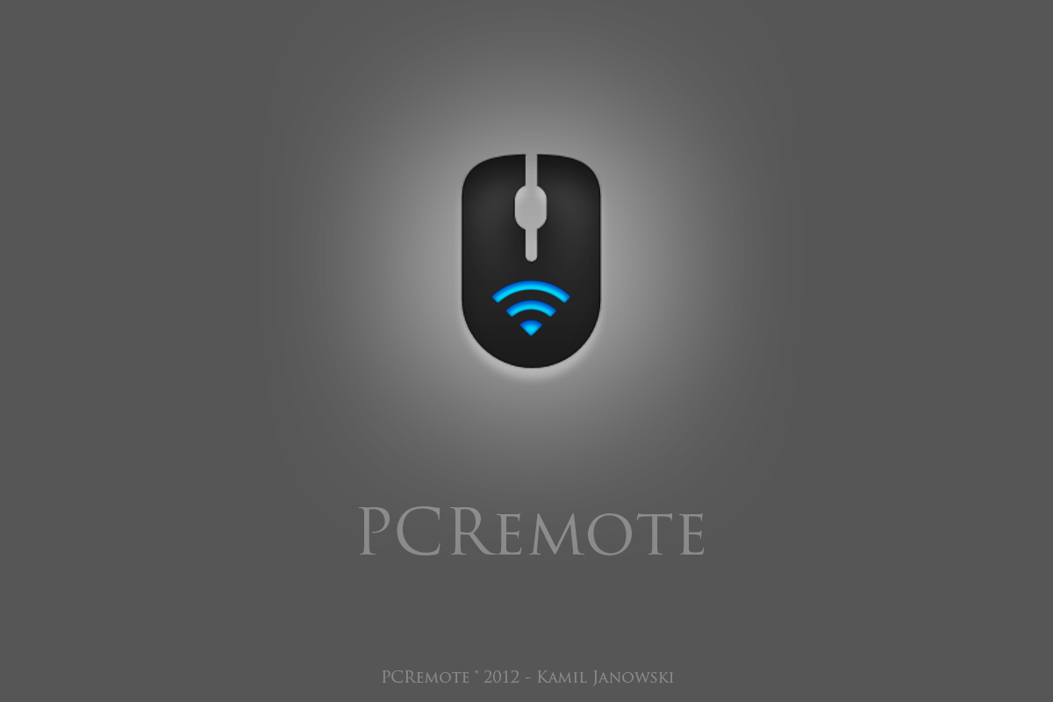

Slide 2
General idea
Project consists of two applications:
1. PCRemote Server running on computer you want to control.
2. PCRemote Client running on Windows Phone device.
Project allows to take the control over the cursor and the keyboard of a computer with a WP7 device.
Server and client communicate via Wi-Fi.

Slide 3
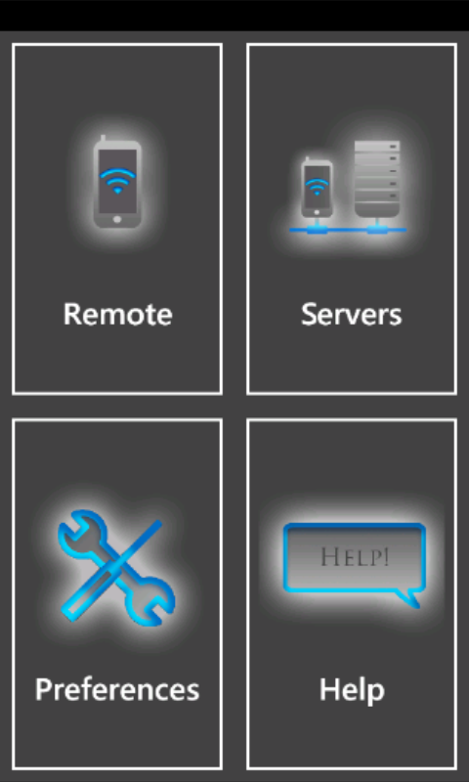
Client – main window

Slide 4
Client
Clients use multiple different transport protocols to communicate with the server depending on what kind of message they want to send.
At first client needs to establish TCP session with server that will be used to send keyboard events as well as receive live updates that might be implemented in the future.

Slide 5
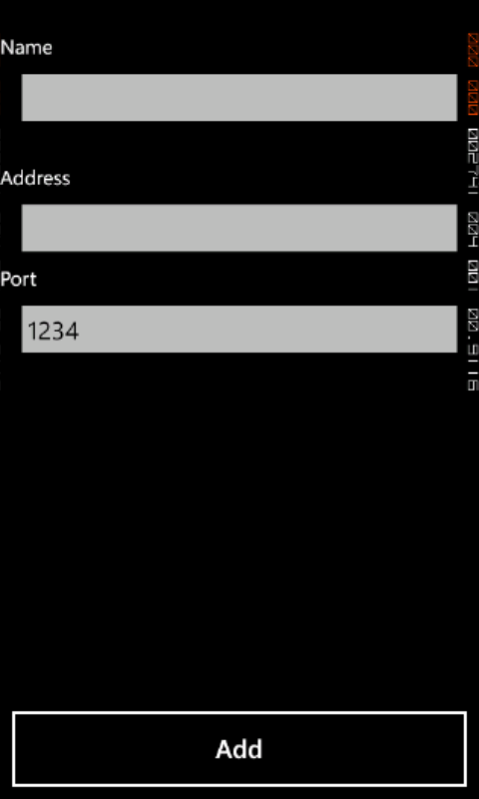
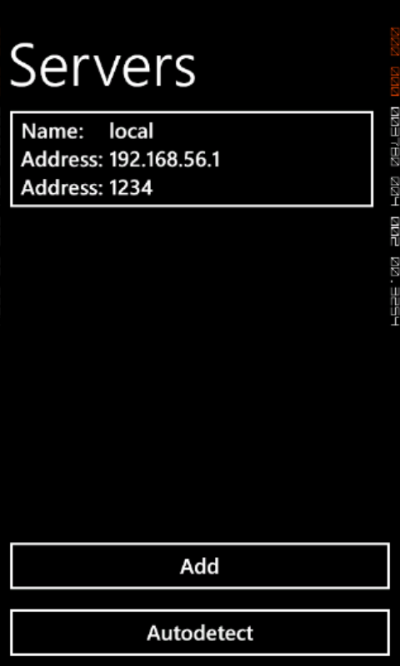
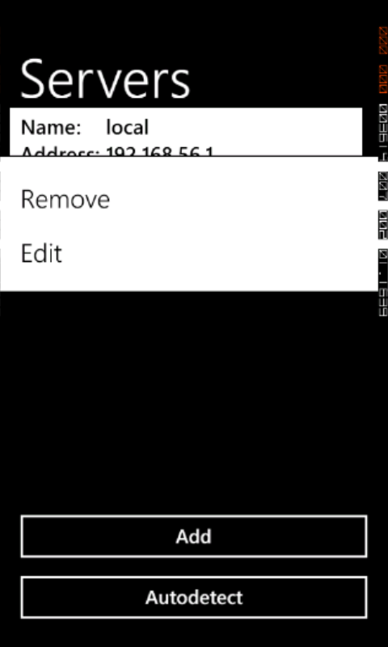
Client
Technology differences

Slide 6
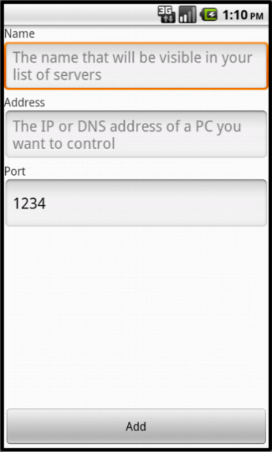
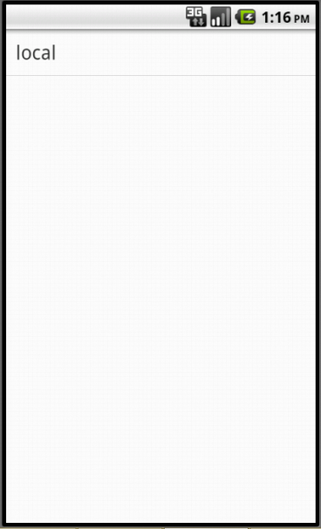
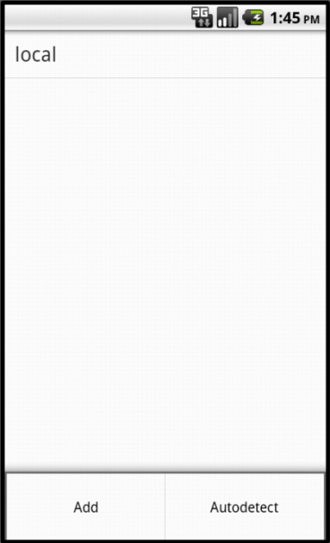
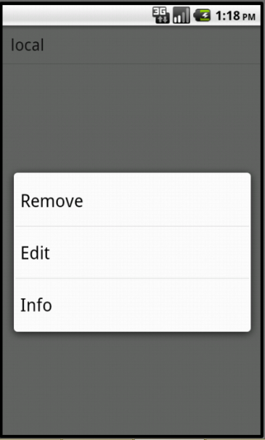
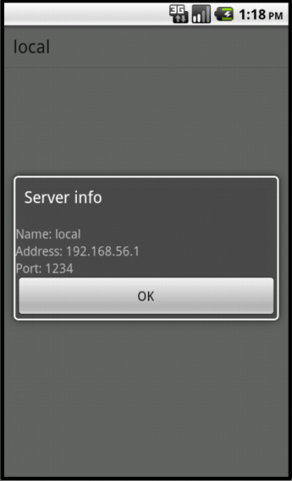
Client

Slide 7
Client – how it works
Controllers
Network Message
Sending thread
Mouse controller
Mouse movement
Keyboard controller
Key pressed
Protocol type
Address
Message

Slide 8
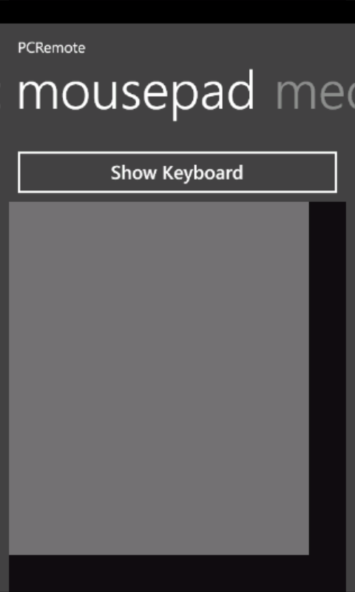
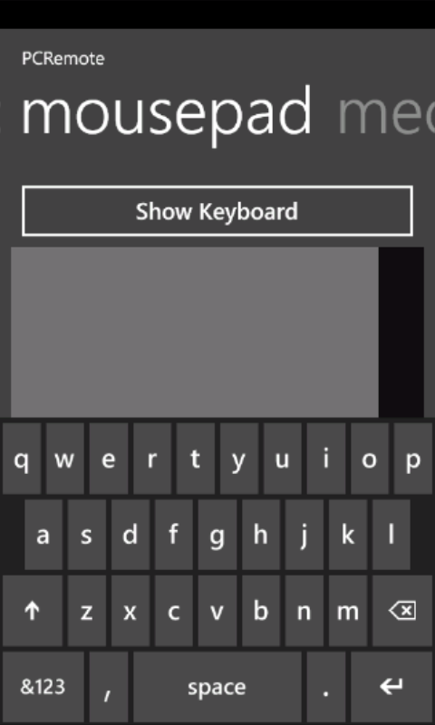
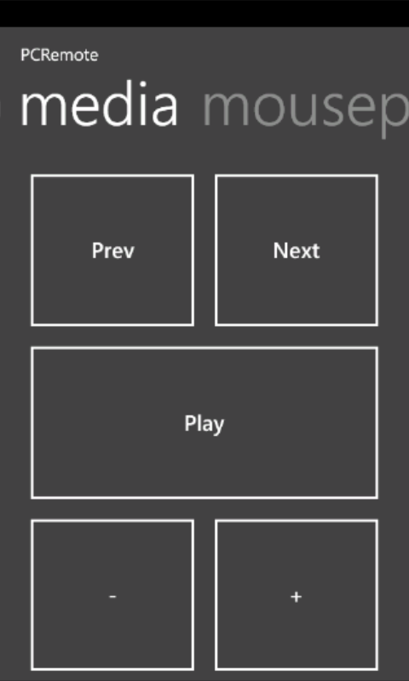
Client – controllers

Slide 9
Client
Using software keyboard
Both in Android and Windows Phone 7 you can easily show the software keyboard by calling one method, but there is no way to capture the input.
The easiest way then is to create a separate control/view that accepts keyboard input, hide it from the user and put a button that sets focus on the control/view.

Slide 10
Client – synchronization
Thread synchronization is solved differently in WP and Android clients.
While Dalvik contains almost entire implementation of Java SE, Windows Phone is restricted to using only .NET Core, what means it lacks many important features, including many essential synchronization features.

Slide 11
Client – touch consumption
Event consumption is solved in a totally different way in Android and Windows Phone.
Android
boolean onTouchEvent(MotionEvent e)
Windows Phone
Event ManipulationStarted
Event ManipulationDelta
Event ManipulationComplete
Event MouseMove
event.Handled = true

Slide 12
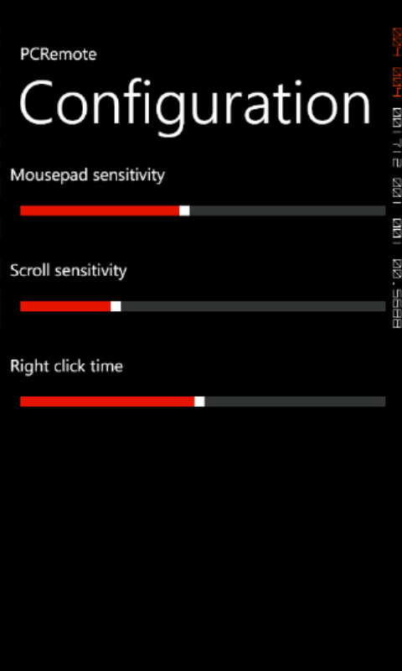
Client – configuration

Slide 13
Client – data storage
Both android and Windows Phone support creating private files.
They both provide a different way of accessing files than in native languages.
.NET in Windows Phone doesn’t support object binary serialization, but does provide XML object serialization.

Slide 14
Server
Uses two different technologies: Qt Framework and WinAPI.
Although Qt is a great tool for creating windows or managing network traffic, it has many restrictions that make it impossible to create this kind of a server using only this framework.
No Linux natively supports simulating mouse click, scroll or keyboard button press, therefore neither does Qt. Still, WinAPI does support them.

Slide 15
Server – data storage
C++ doesn’t provide any mechanism for object serialization, but provided that object doesn’t contain any pointers, it can be done easily anyway.
char * c = (char*) &o;
for ( int i = 0; i < sizeof(O); i++ )
out.put( c );

Slide 16
Server – definition
Server is a boring application that provides data and does a lot of operations that cool applications request it to perform.
In other words, there’s not much to say about it…

Slide 17
